Slide 1
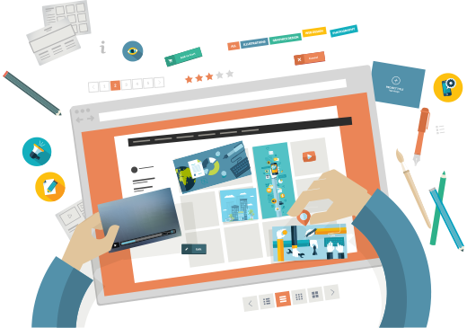
15 UI Templates
(46-60)
Members:
Lâm Thành Tài 15110121
Lê Mỹ Thiên Thanh 15110124

Slide 2

Content
Invoice
Activity Feed
Coming Soon
Notifications
Job Listing
Press Page
Daily UI Logo
Header Navigation
Confirm Reservation
Icon set
Breadcrumbs
Video Player
Shopping Cart
Background Pattern
Color Picker

Slide 3
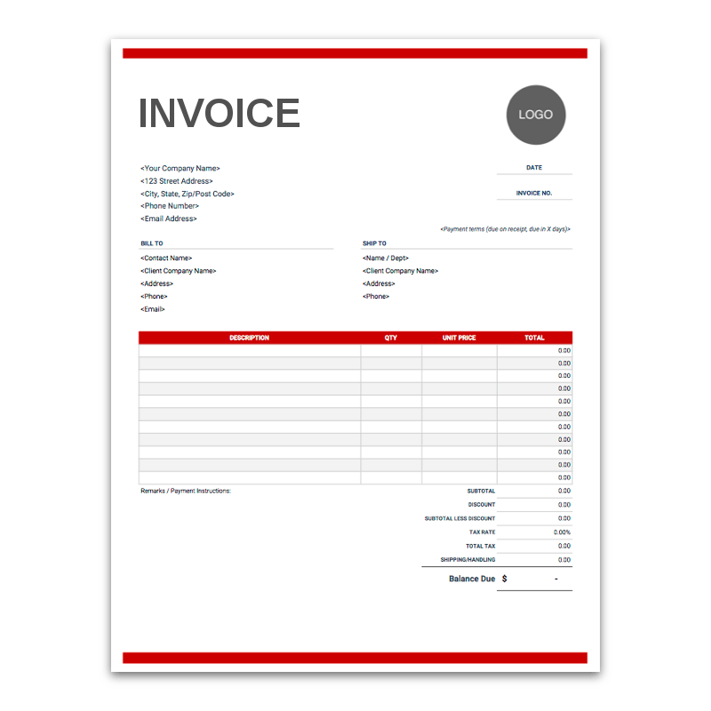
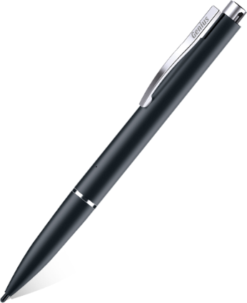
Introduction
Invoice
Interchanged with billing functionality.
Indicating a list of the products or services, quantities, and agreed prices for products or services the seller had provided the buyer.
Follows a certain template of each corporation

Slide 4
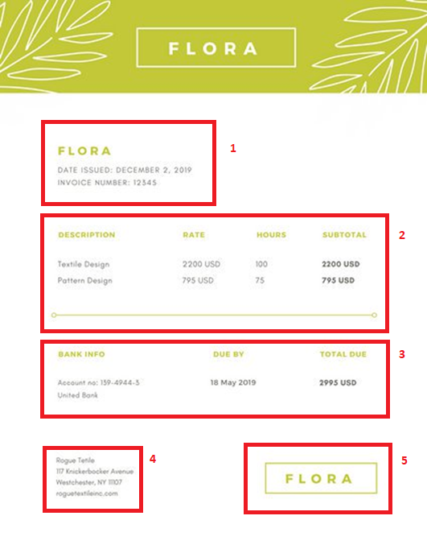
component
Invoice
Invoice’s Information
Extra Description
1
List of products/services and cost
5
2
Corporation’s Information
4
3
Summary

Slide 5
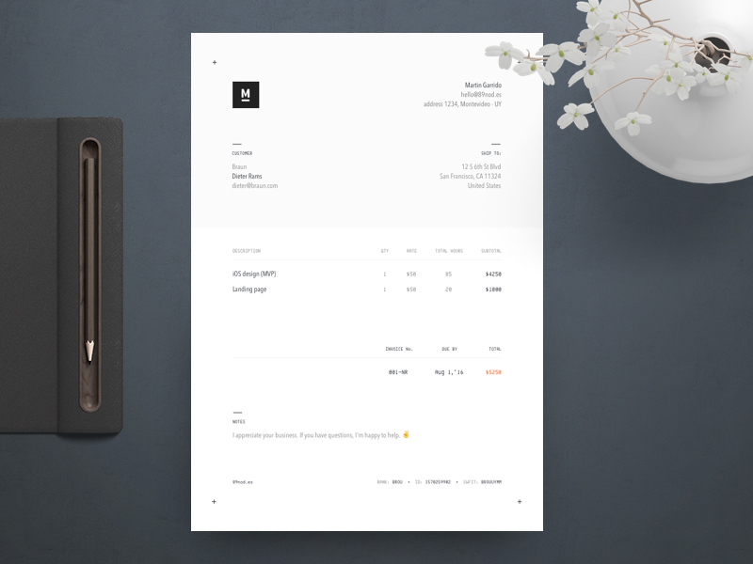
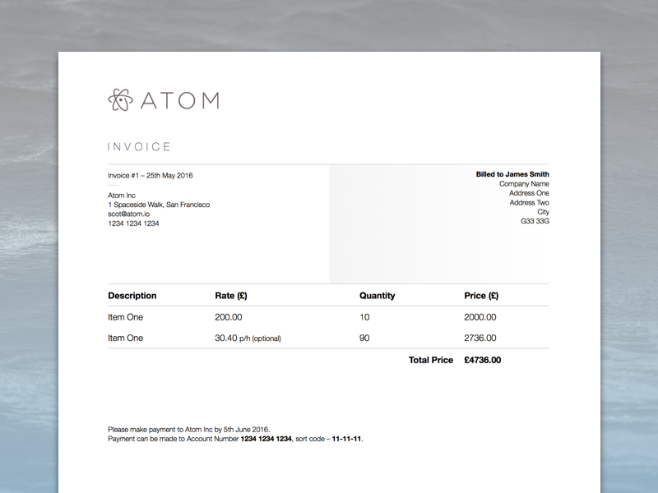
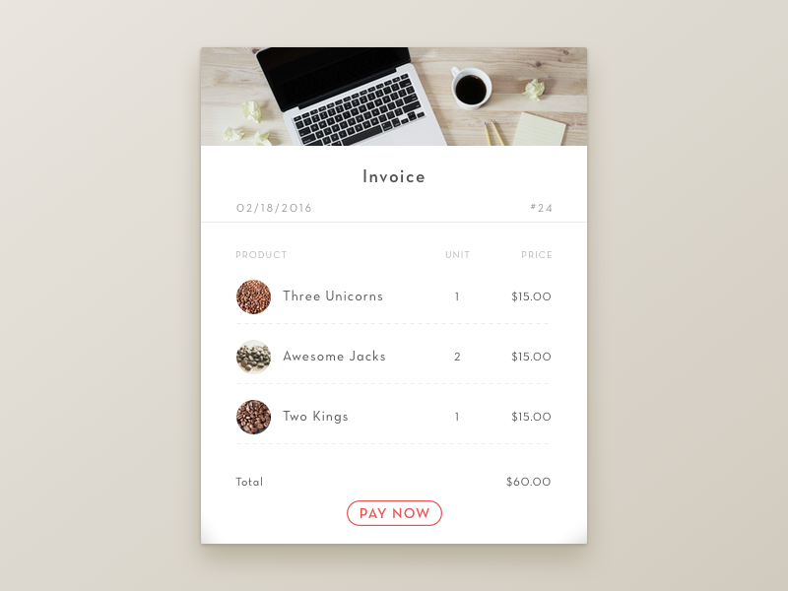
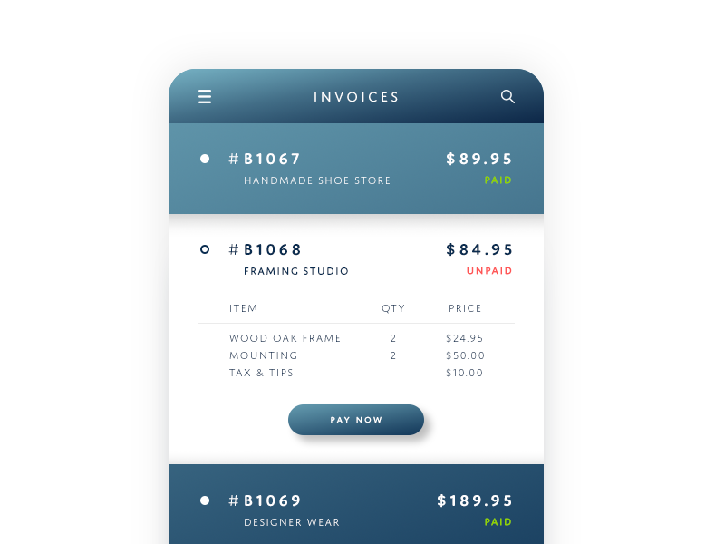
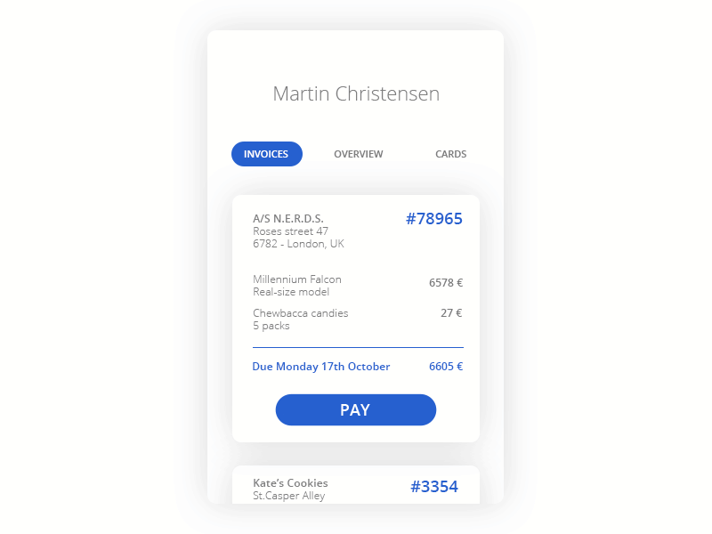
Example
Invoice

Slide 6
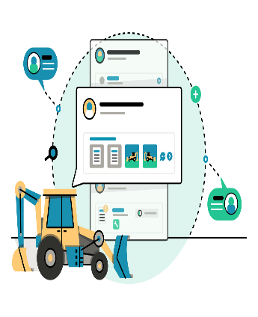
Introduction
Activity Feed
Delivers the experience and benefits of the social feeds.
Offers an open feed to all app users where image or text can be posted for everyone to see, like, or join the conversation.

Slide 7
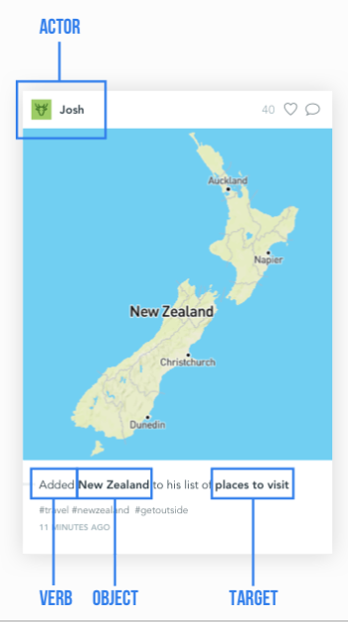
component
Activity Feed
Actor
Extra Information
1
Verb
5
2
4
3
Target
Object
Extra Info

Slide 8
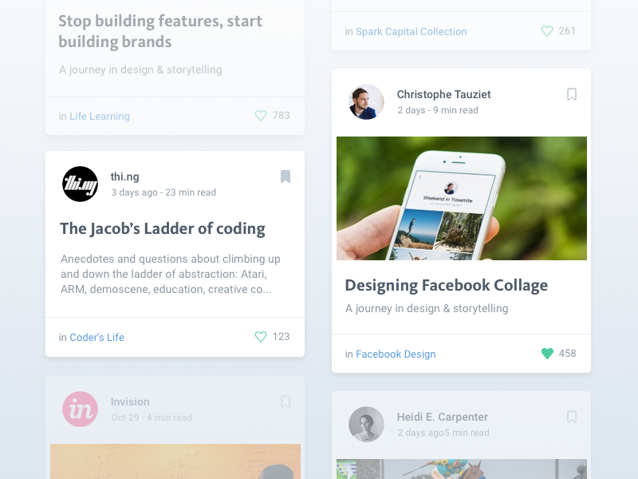
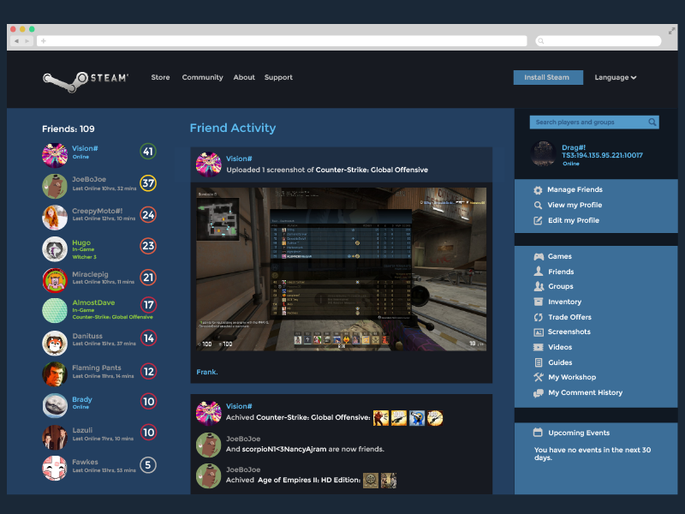
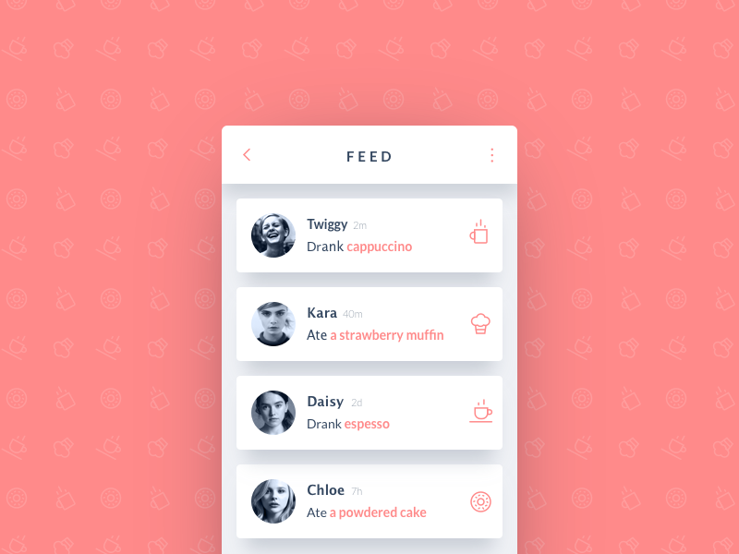
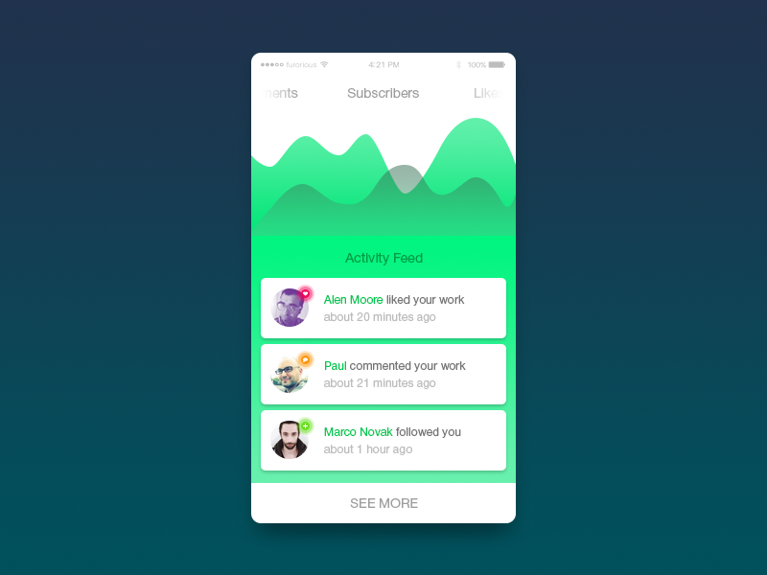
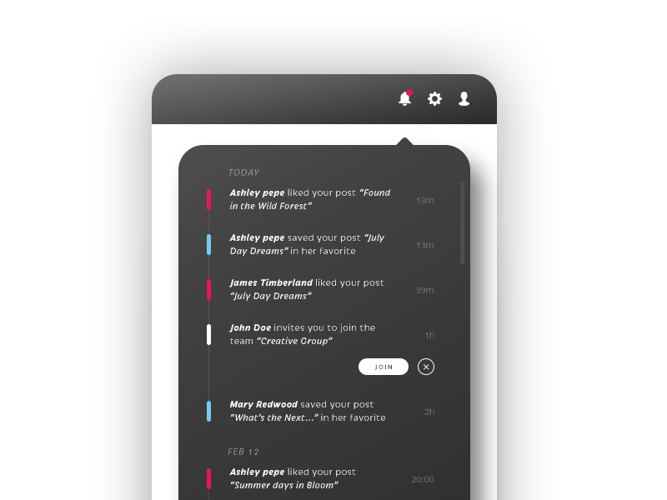
Example
Activity Feed

Slide 9

Introduction
Coming Soon
Informs users about the invention or new upgrade from your product or service
Collecting user information such as email, phone numbers to send referrals earlier is an attractive feature.

Slide 10
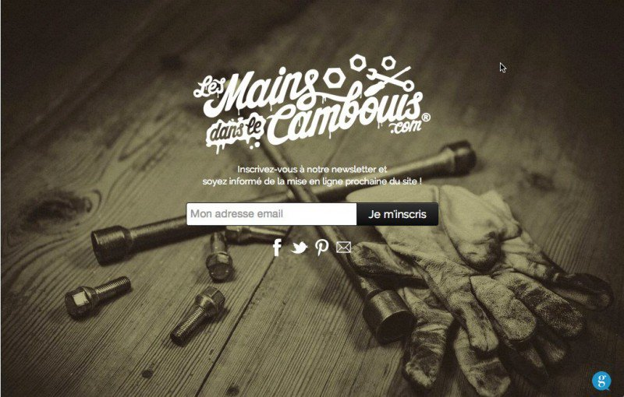
component
Coming Soon
1
Name of product/Service
2
Extra description
3
Get user’s information

Slide 11
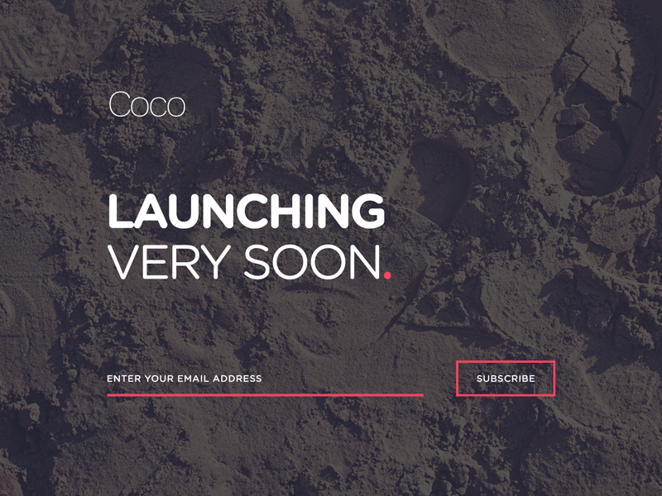
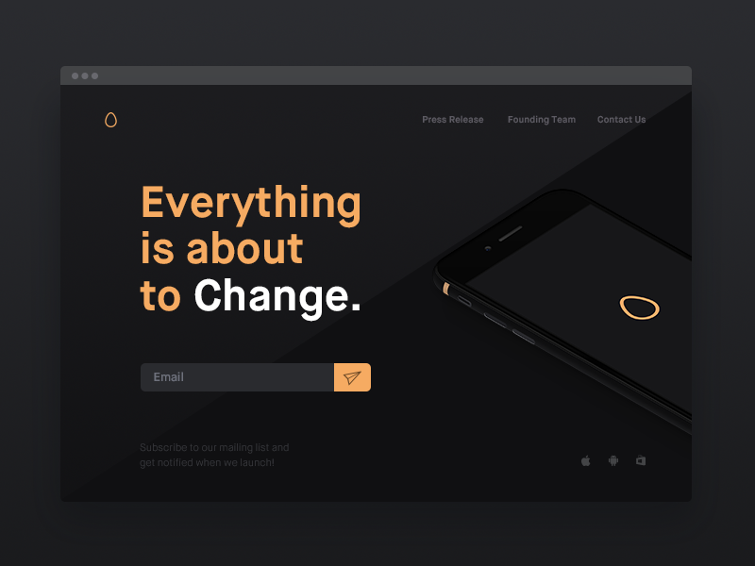
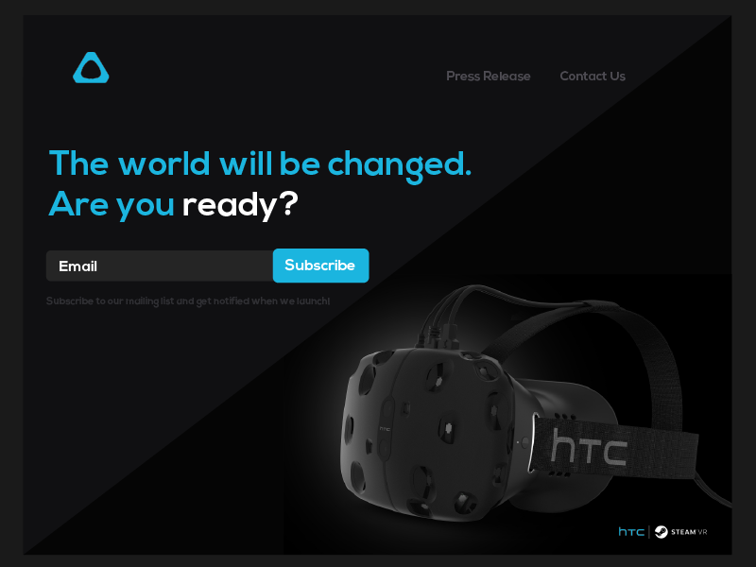
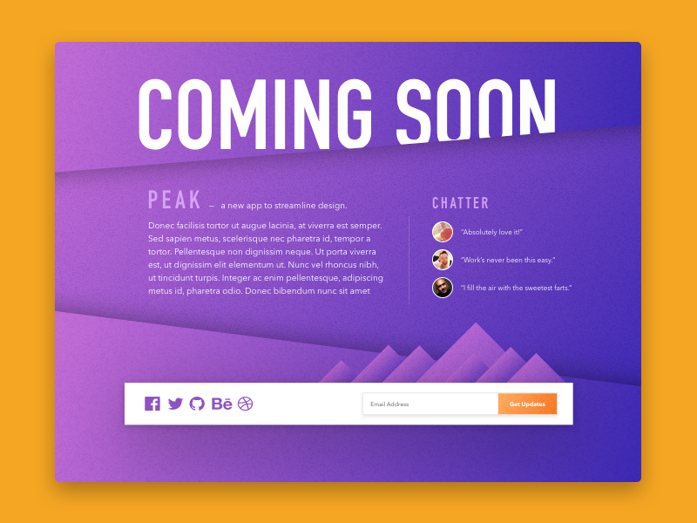
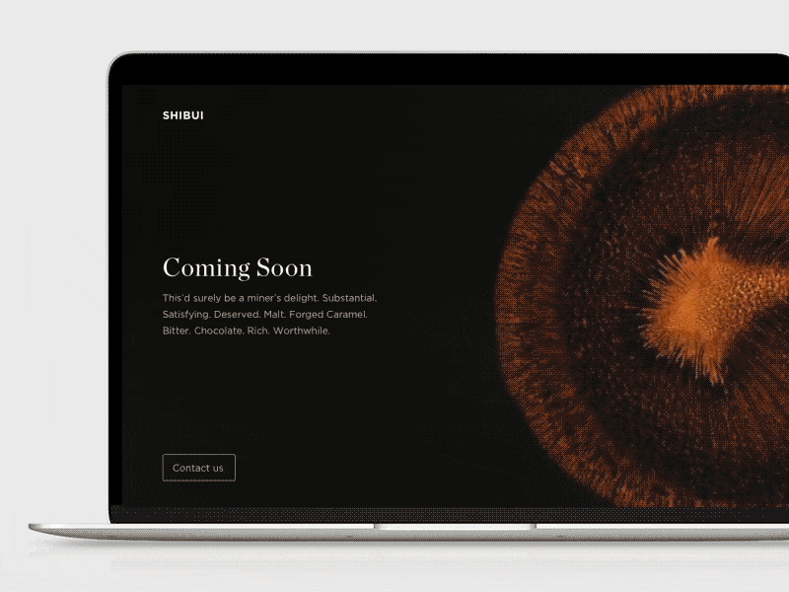
Example
Coming Soon

Slide 12


Introduction
Notifications
Provides an overview of alerts from applications or users' interaction

Slide 13
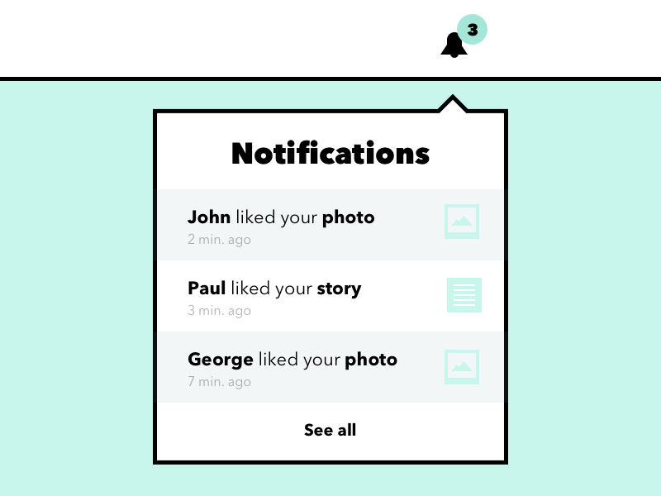
component
Notifications
1
Summary
2
Content
3
Optional button

Slide 14
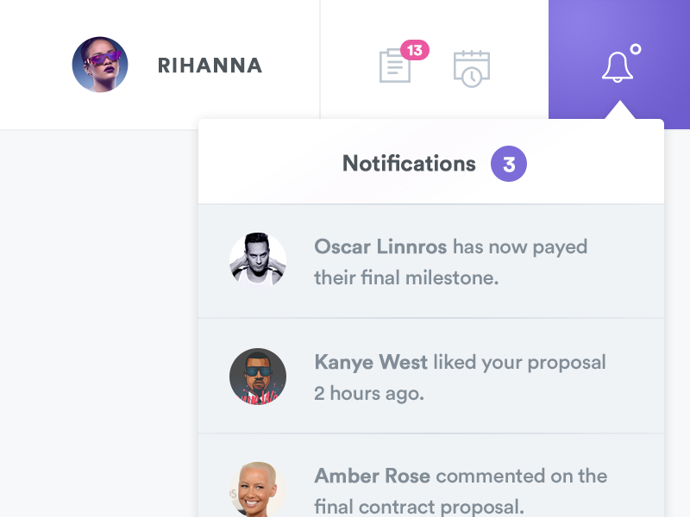
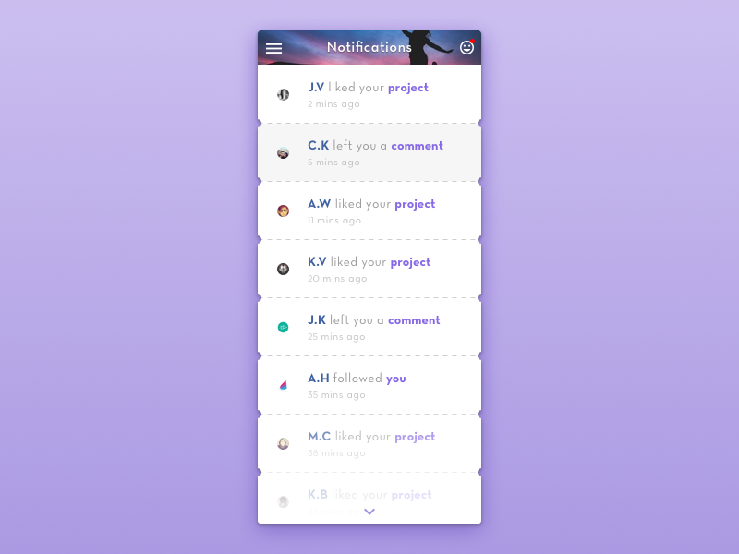
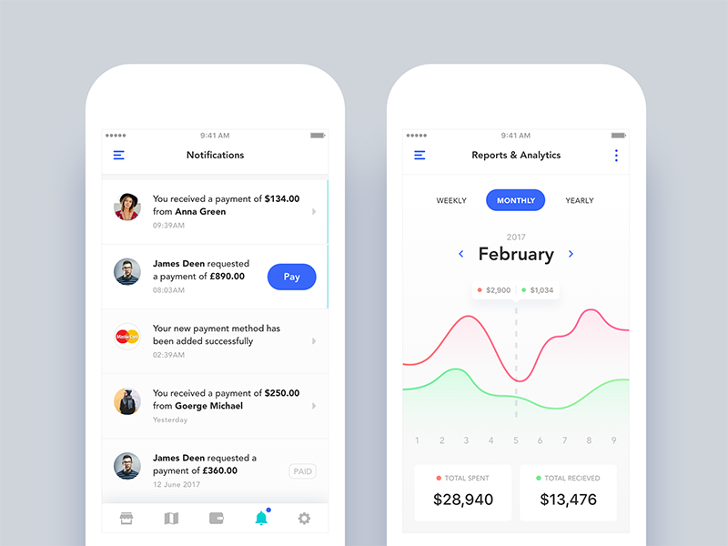
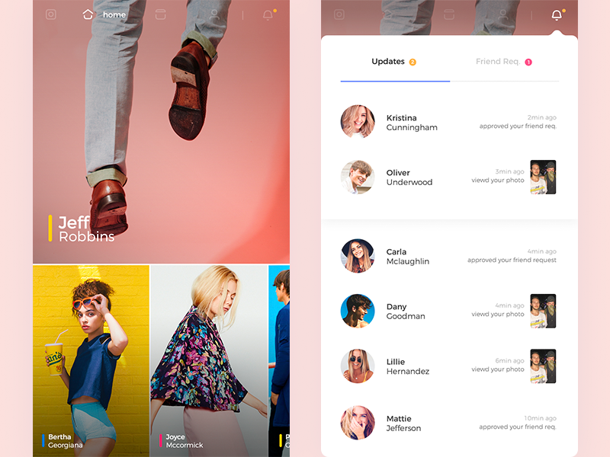
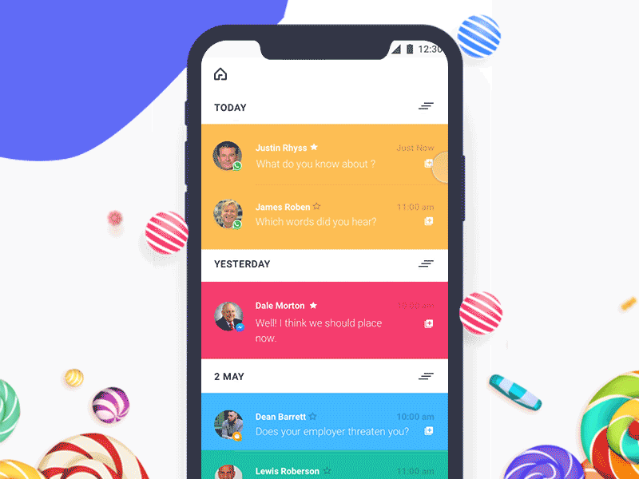
Example
Notifications

Slide 15

Introduction
Job listing
Displays a list of open positions (with their descriptions and requirements) so that the candidates can apply.

Slide 16
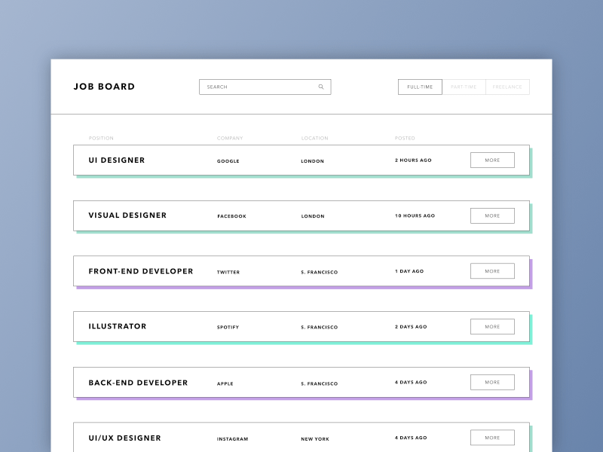
component
Job listing
Search engine and filters
1
2
Job listing
3
Detail button

Slide 17
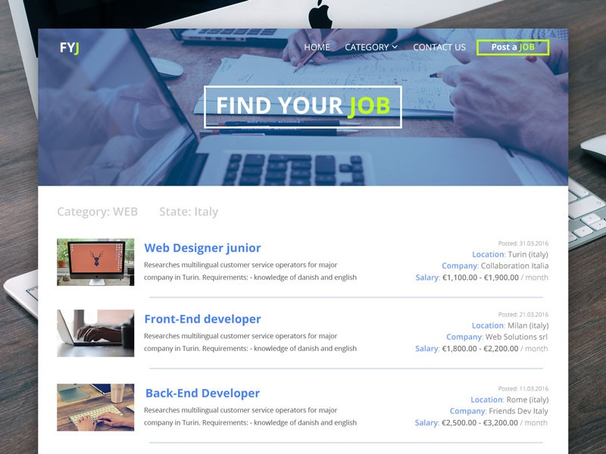
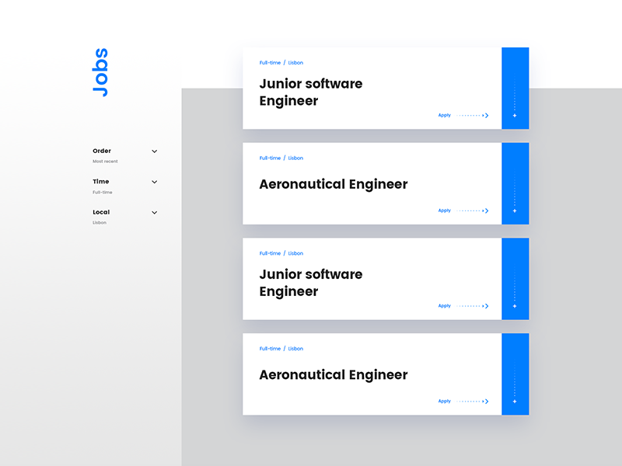
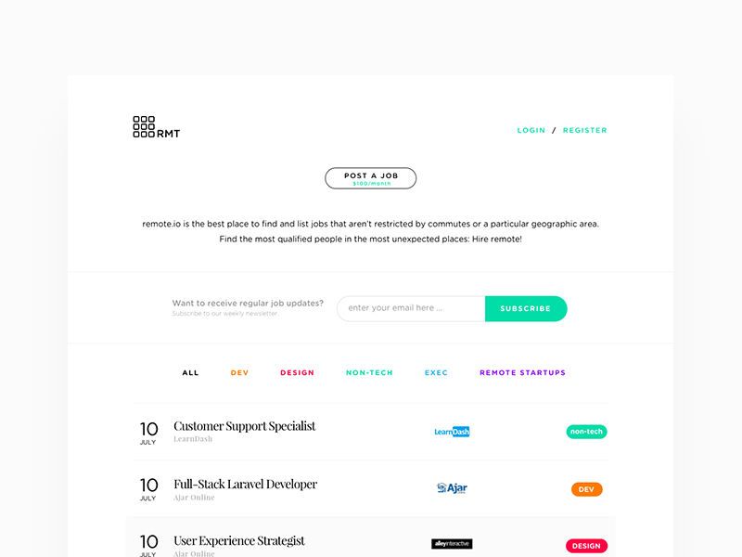
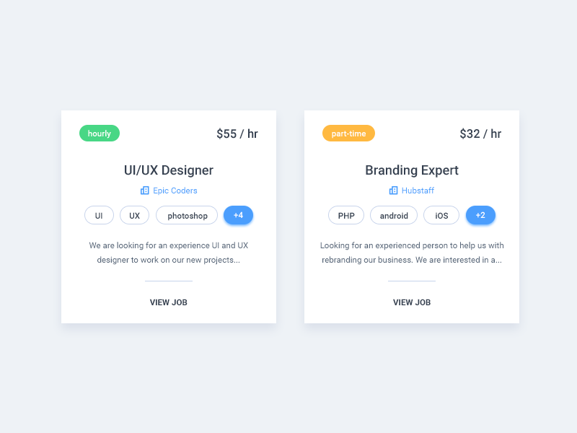
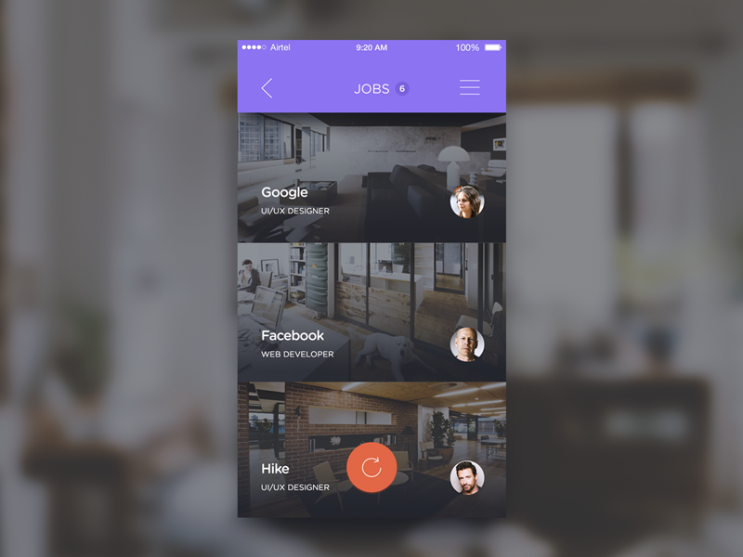
Example
Job listing

Slide 18

Introduction
Press Page
Interchanged with Media page or News page.
It is an essential element of any public relations strategy
It is for those people who want to learn more about your company
You can educate potential customers and the media about what is going on at your organization

Slide 19
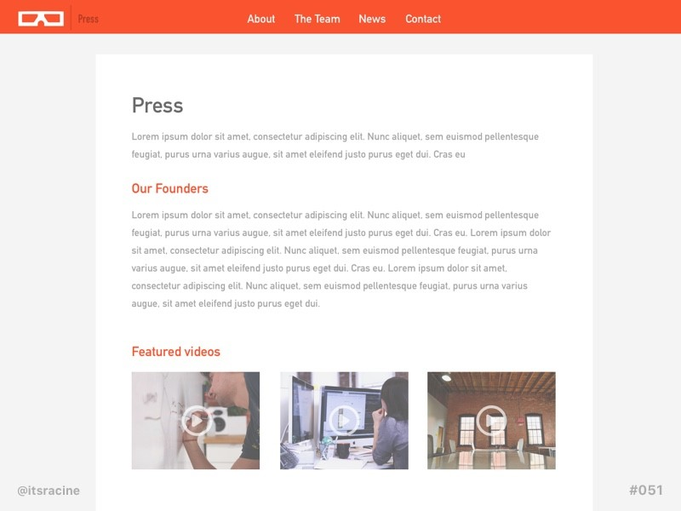
component
Press Page
News articles
(Offline-News cutting &
Online- links/screenshots)
TV/ Online Portal video
coverage

Slide 20
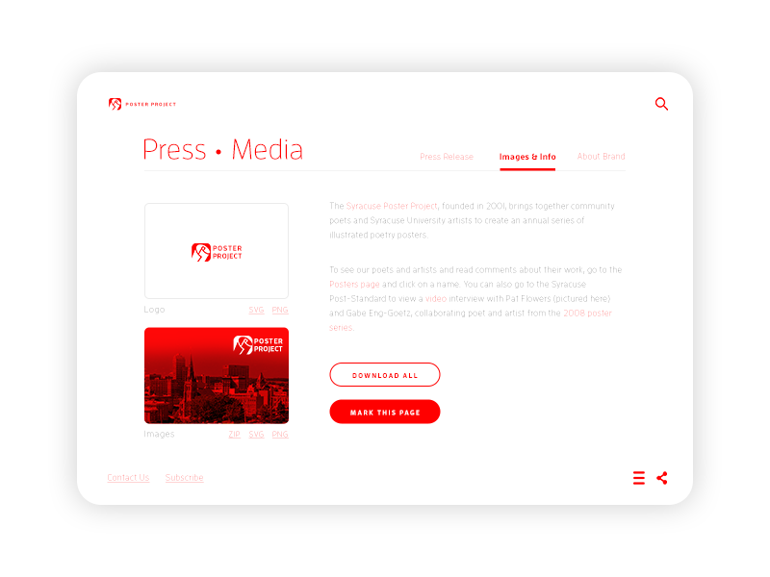
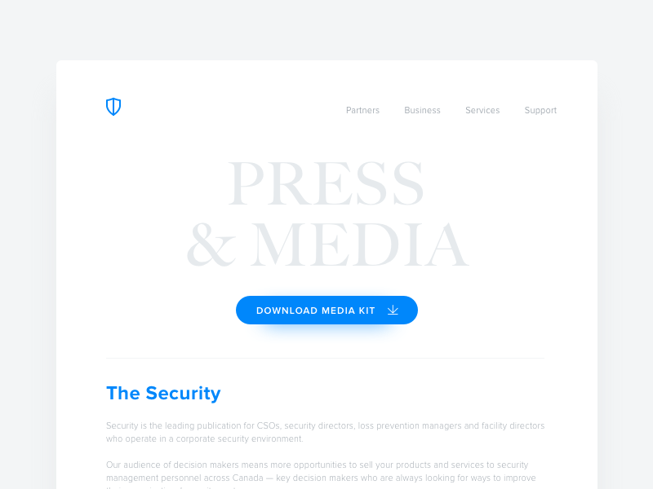
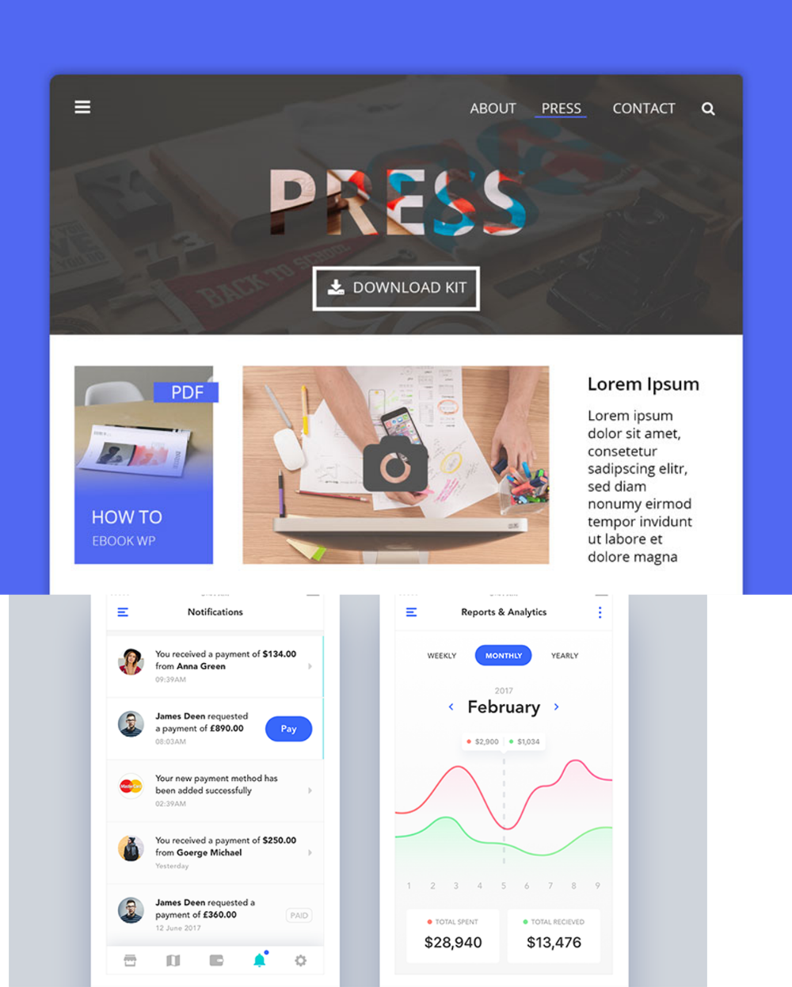
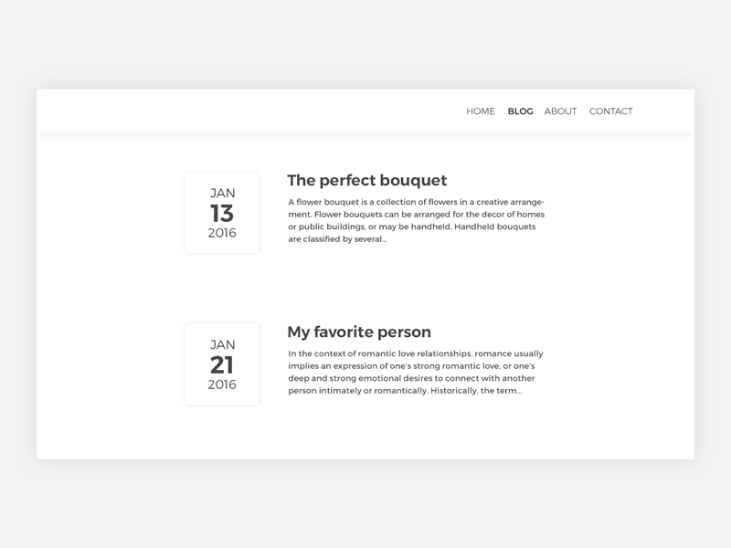
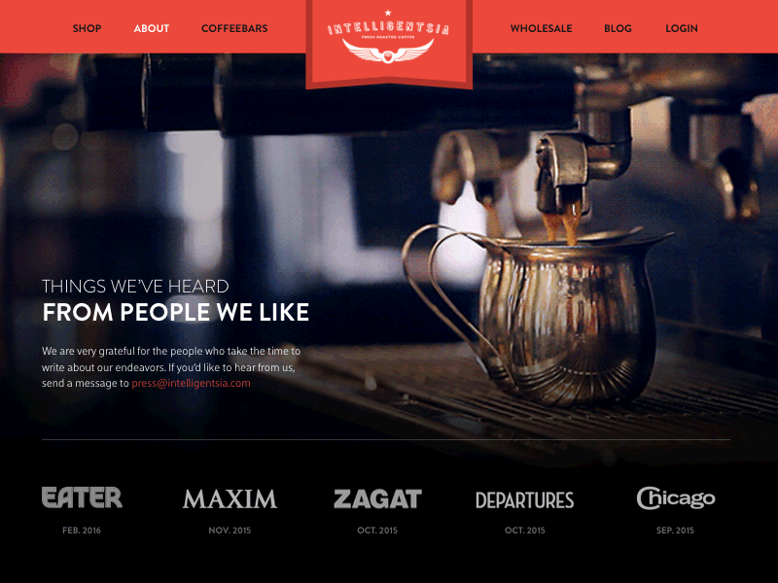
Example
Press Page

Slide 21

Introduction
Daily UI Logo
Daily UI is a series of daily design challenges design inspiration and neat surprise rewards.

Slide 22


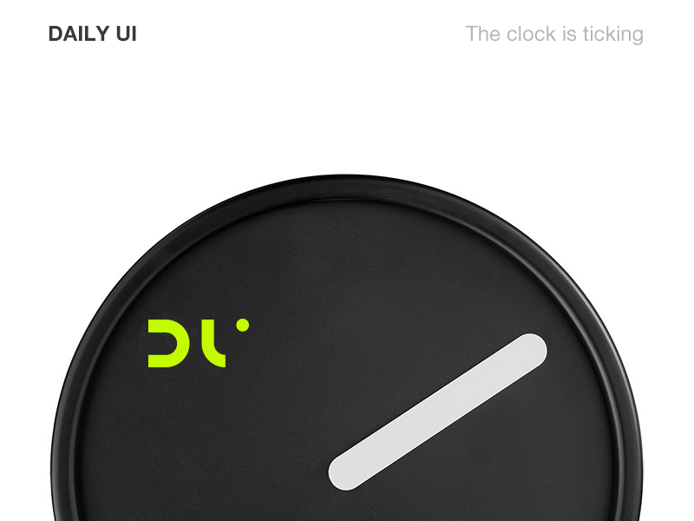


Example
Daily UI Logo

Slide 23
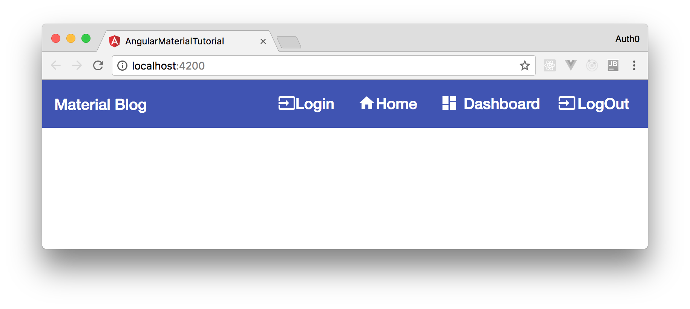
Introduction
Header Navigation
A user interface element within a webpage that contains links to other sections of the website.
In most cases, no matter what page you are viewing, you can use the heading navigation to visit other sections of the website.

Slide 24
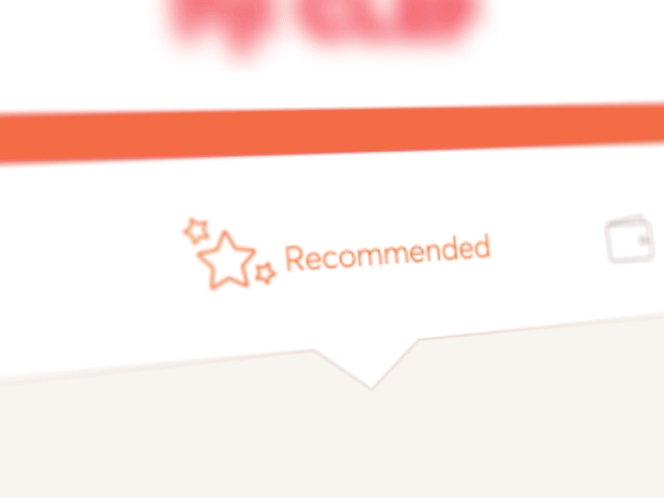
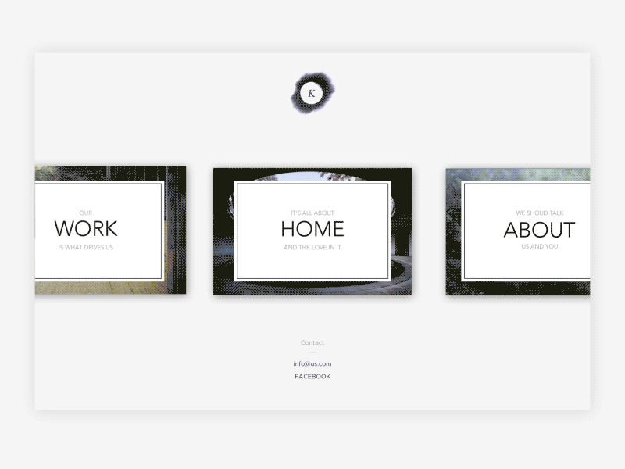
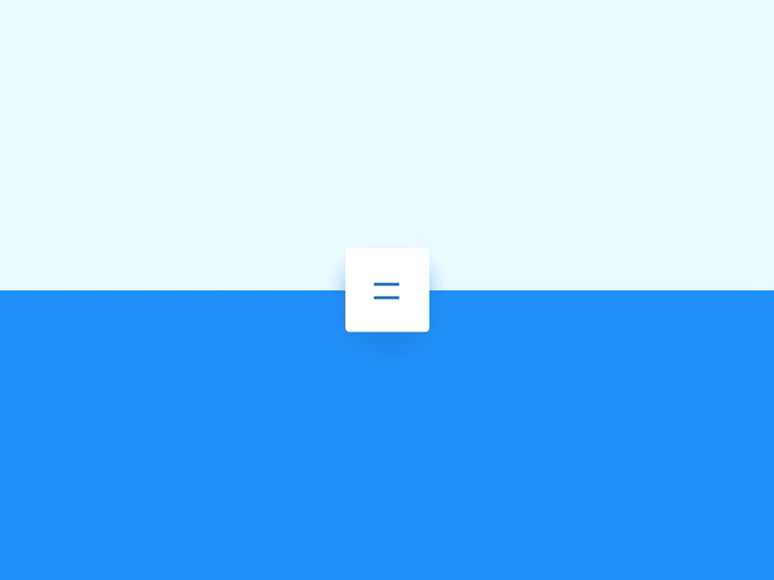
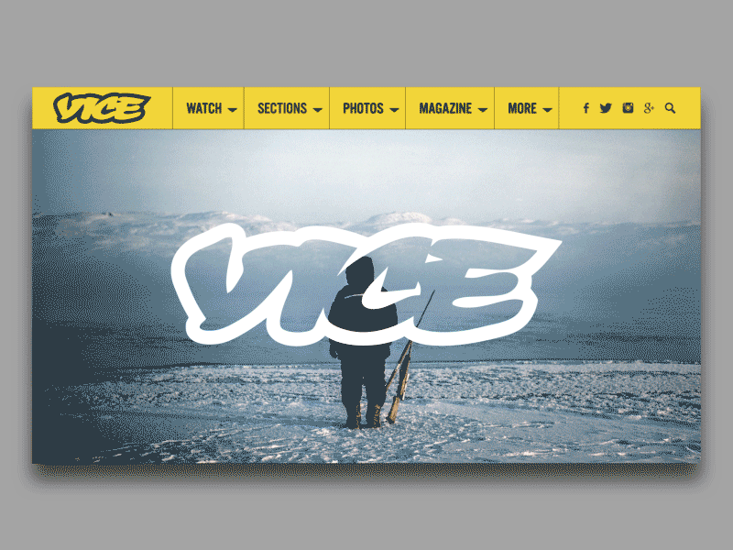
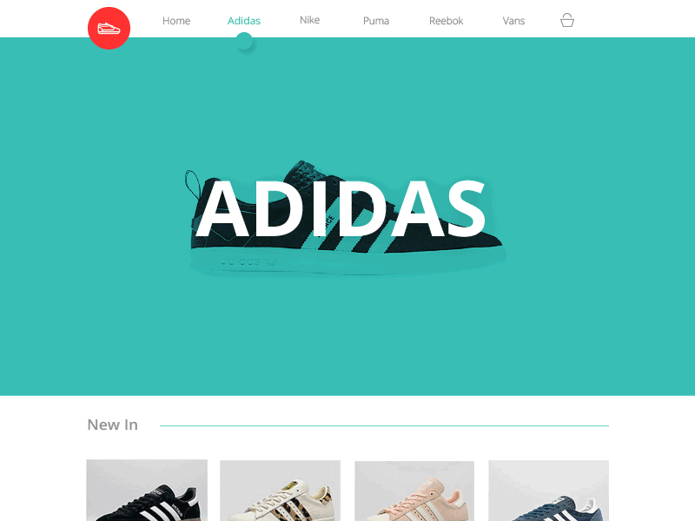
Example
Header Navigation

Slide 25

Introduction
Reservation
An arrangement in which something such as a seat on an aircraft or a table at a restaurant is kept for you.
An act of reserving something.
Something reserved.

Slide 26
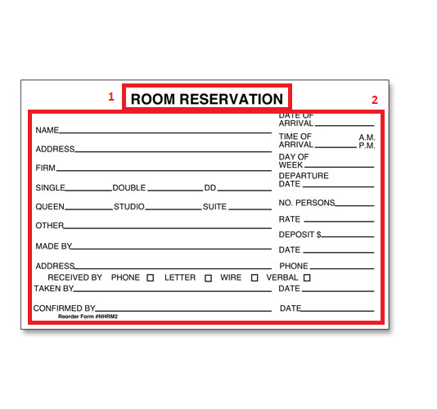
component
Reservation
1
Reservation’s Name
Information of reservation
2

Slide 27
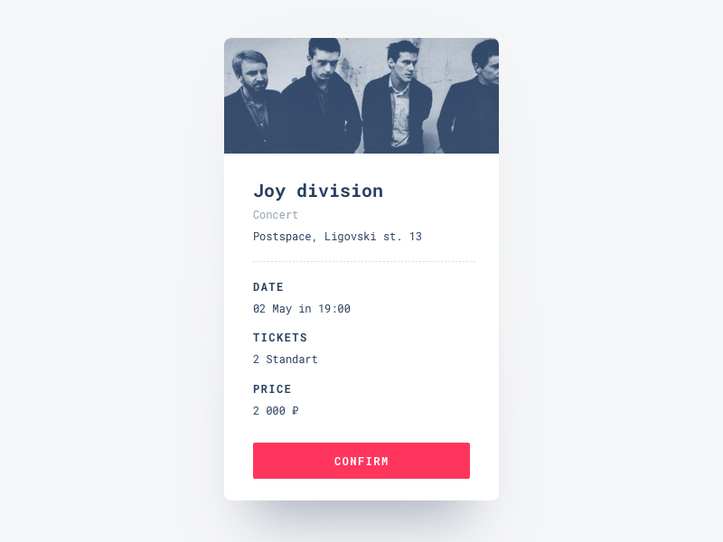
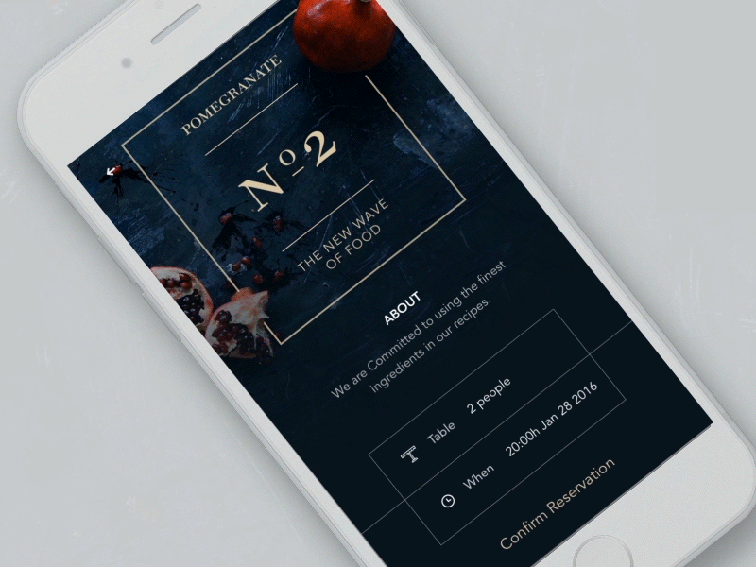


Example
Reservation

Slide 28

Introduction
Icon Set
A set of flat design icons featuring workspace elements. The icons are freely available to be used for your personal and commercial projects.

Slide 29

component
Icon Set
This picture expresses special properties of this feature

Slide 30




Example
Icon Set

Slide 31

Introduction
Breadcrumbs
A “breadcrumb” (or “breadcrumb trail”) is a type of secondary navigation scheme that reveals the user's location in a website or Web application.
The term comes from the Hansel and Gretel fairy tale in which the two title children drop breadcrumbs to form a trail back to their home.

Slide 32

component
Breadcrumbs
This picture expresses special properties of this feature

Slide 33




Example
Breadcrumbs

Slide 34

Introduction
Video Player
Video players commonly display standard media control icons known from physical devices such as tape recorders and CD players, such as play, pause, fast - forward, back-forward, and stop buttons.

Slide 35

component
Video Player
01
02
Video Player
Related Video

Slide 36




Example
Video Player

Slide 37

Introduction
Shopping Cart
A shopping cart is a piece of software that keeps the record of the items a buyer has ‘picked up’ from the online store.
Acting as an online store’s catalog, the E-commerce shopping cart enables consumers to select products, review what they selected, make modifications or add extra items if needed, and purchase the products.

Slide 38

component
Shopping Cart
1
2
3
List of products
Confirm Button
Summary

Slide 39




Example
Shopping Cart

Slide 40


Introduction
Background Pattern
The area or scenery behind the main object of contemplation, especially when perceived as a framework for it.

Slide 41

component
Background Pattern
This picture expresses special properties of this feature

Slide 42




Example
Background Pattern

Slide 43

Introduction
Color Picker
A color picker (also color chooser or color tool) is a graphical user interface widget, usually found within graphics software or online, used to select colors and sometimes to create color schemes.

Slide 44

component
Color Picker
01
02
Color Picker
Color’s Information

Slide 45




Example
Color Picker

Slide 46


Thanks for listening

